Slide 1
Educational Occupancies
Determine what differentiates this type of occupancy from others
Identify the key provisions that are different from the general chapters

Slide 2
Historic Fire
Our Lady of Angels

Slide 3
People
Types of people present
  Familiarity
  Abilities
Activities

Slide 4
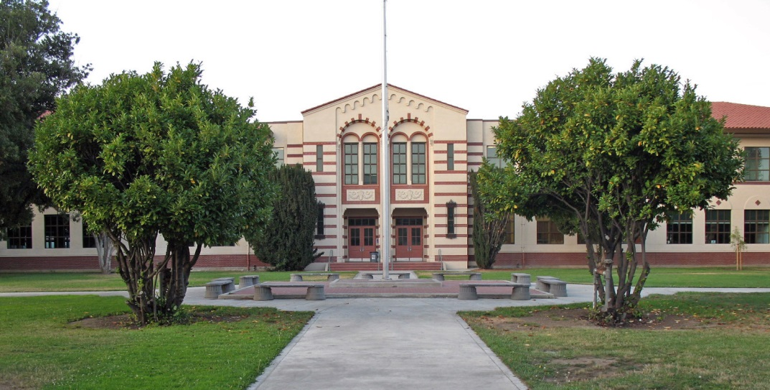
Educational
Not every class
  Grade
  Number of students
  Hours/day
  Total hours
  Incidental
Limitations on room locations

Slide 5
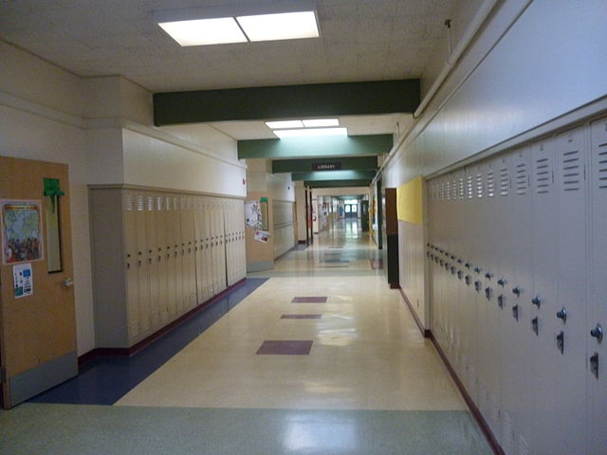
Means of Egress
Wider corridors
Shorter distances
Daily inspections
Lockers and bulletin boards
Classroom door locking
Windows for rescue
  Sprinklers
  Exit door from room
  4+ stories

Slide 6
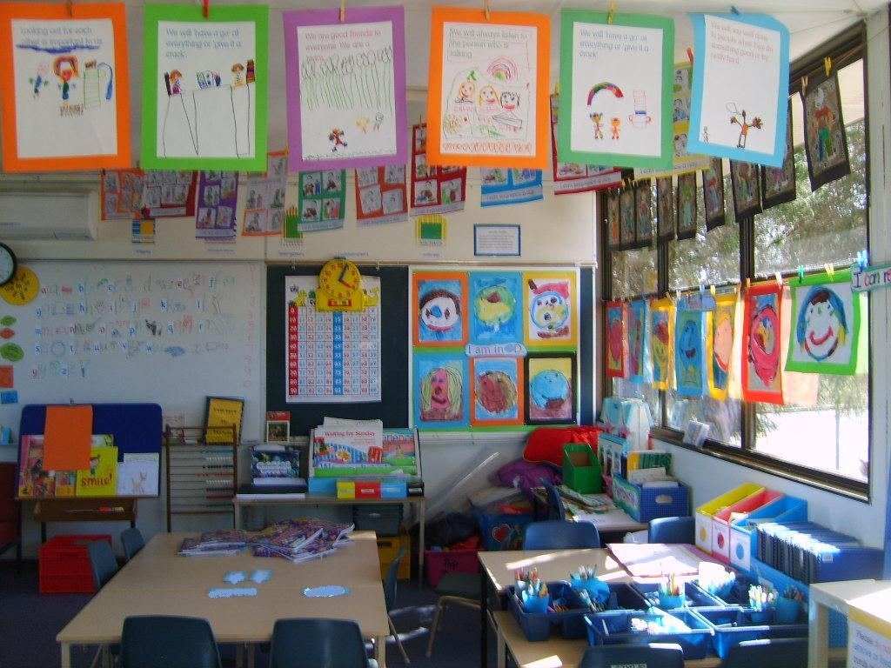
Fire Protection
Monthly drills
  Exceptions
  All participate
Fire alarm bells
Sprinklered
CO detection
Risk analysis
Limits on art work
Open flames (labs)

Slide 7
Day Care
Day Care
Day care homes
Adult
Children

Slide 8

Day Care
Complying with Fire
I-4 Day care
  More than 5 people in IBC
  1-5 people: Primary occupancy
  < 24 hour care
  Adult
  Child
Oklahoma
  7 children
  8-12 Residential with sprinklers
LSC
  More than 3 people

